Slide 1

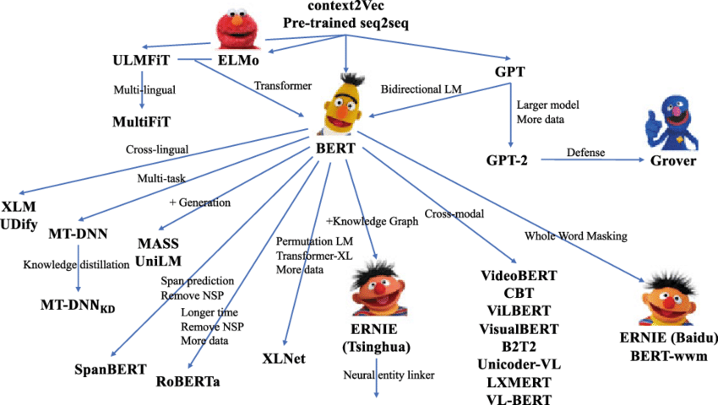
Introduction to the family of BERT transformer models
Thierry Desot

Slide 2

Machine learning – deep learning
BERT transformer model
Sentiment analysis – zero shot learning

Slide 3
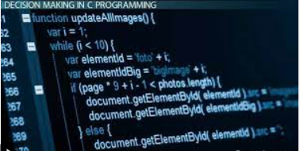
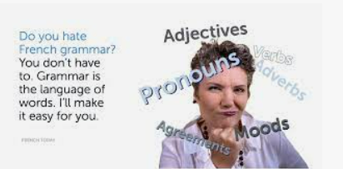
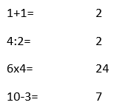
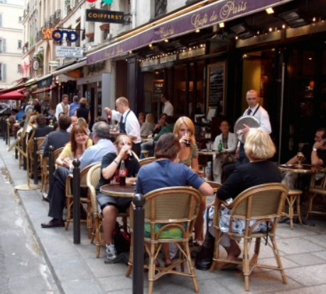
Machine learning
Computer software / rules
Developer writes code, rules
Instructs system to react to a situation
Cannot deal with new situations:
Rules or data to be updated
Like a language course focusing on learning
grammar rules and vocabulary
Machine learning
Trained on a large number of data, examples
Data-driven
Learns based on experience
Infers rules itself : functions
Can deal with new situations
Like a language course focusing on practice
For deep learning : open source frameworksTensorFlow, Keras, PyTorch
3x² + 2x + 4

Slide 4
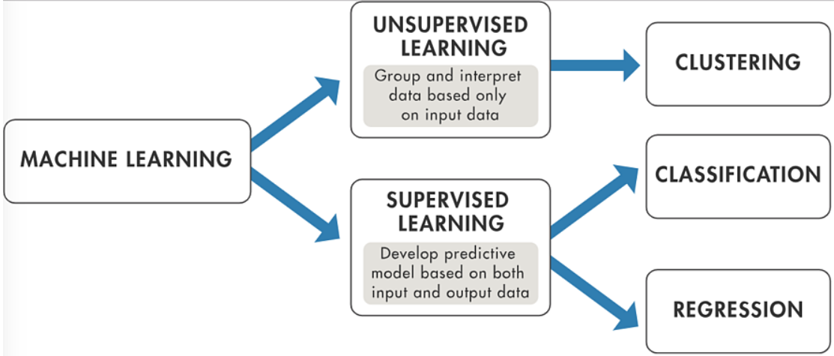
Machine learning

Slide 5
Machine learning
Transformer model
For downstream NLP task : semi-supervised

Slide 6
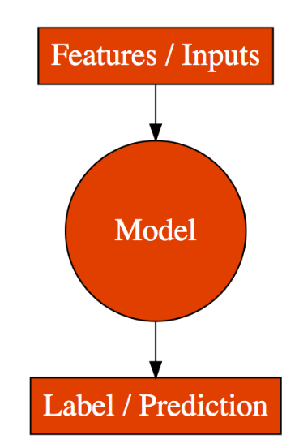
Machine learning : supervised learning
Supervised learning
Features and label
For example: color, shape feature for image classification
Feature engineering : manual selection and processing of features
Features automatically learnt (deep learning)
Labeled data
Linear regression
Label is a numeric value
Prediction of rent
Input Label
This apartment has a surface of 200 m² and is located in the city center of Brussels. -> 2000 (Euro rent / month)
Features
surface : 200 m²
location : city center

Slide 7
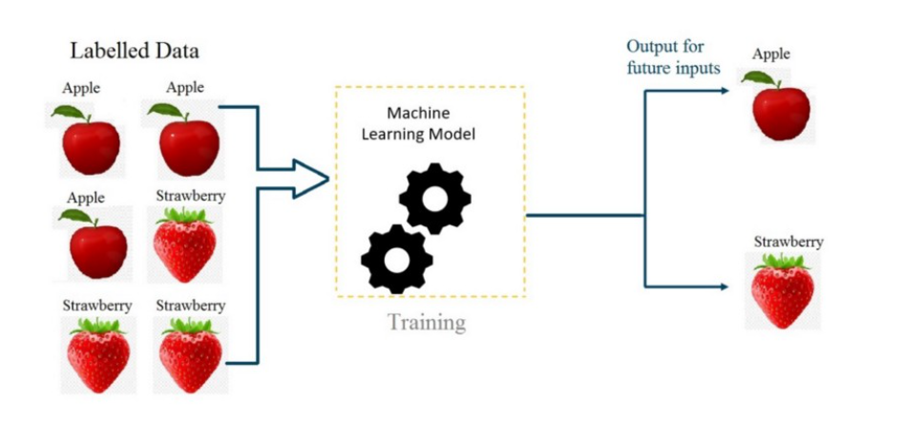
Machine learning : supervised learning
Supervised learning
Classification – logistic regression
Category label
Image classification
Sentiment analysis
Input Label
I feel depressed because the weather is so bad. -> Negative sentiment
Adjective features

Slide 8
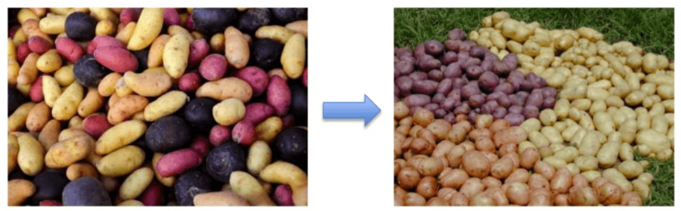
Machine learning
Unsupervised learning
Clustering : group similar entities
Cluster data into groups
Discover unknown patterns
in unlabeled data sets

Slide 9

Machine learning
Unsupervised learning
Clustering : group similar entities
Cluster data into groups
Discover unknown patterns
in unlabeled data sets
Reinforcement learning
Rewarding desired behaviors and/or punishing undesired ones
A reinforcement learning agent perceives and interprets its environment
Takes actions and learns through trial and error

Slide 10
Machine learning - deep learning
Data set
Training set to create the machine learning model
Validation set to fine-tune model and improve performances
Held-out test set informs us about the final performance of the model after completing the training phase
80% TRAINING SET
10% VALIDATION SET
10% HELD-OUT TEST SET
Data set:
10K
instances

Slide 11
Machine learning - deep learning
Supervised learning : deep learning – deep neural networks
Model based on functioning of neurons, neuron layers in the brain
Feature engineering | Deep learning
Manual feature selection and engineering | Infers features itself
Data set of 10K instances | Data set of 100K instances Larger data sets needed
CPU sufficient | GPU required
< 1 hour of training time | Hours, days of training time

Slide 12
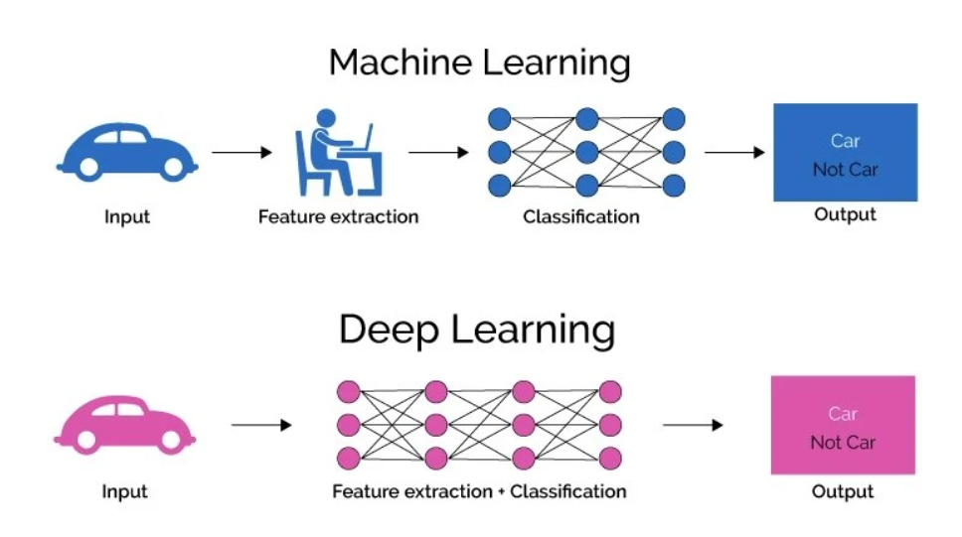
Machine learning - deep learning

Slide 13
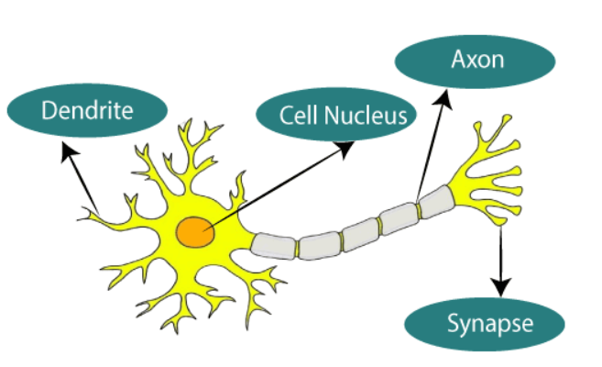
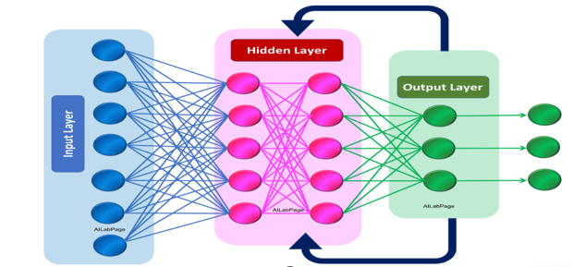
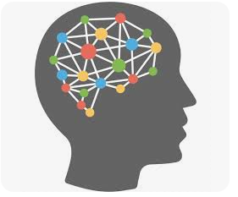
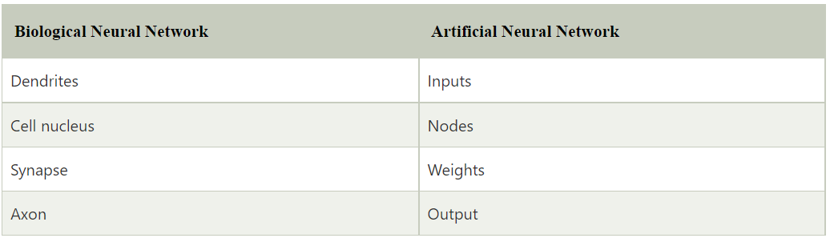
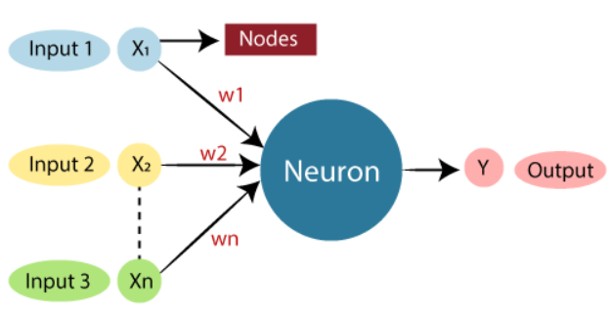
Machine learning - deep learning
Supervised learning : deep learning – deep neural networks

Slide 14
Machine learning - deep learning
Supervised learning : deep learning – deep neural networks
Applied to sentiment analysis / classification
3 possible labels
Negative
Positive
Neutral
The weather is rainy, which depresses me -> Negative
I feel great today -> Positive
It is 10 degrees outside -> Neutral

Slide 15
Machine learning - deep learning
Applied to sentiment analysis
The
weather
is
rainy,
which
depresses
me
encoder

Slide 16
Machine learning - deep learning
Applied to sentiment analysis
The
weather
is
rainy,
which
depresses
me
encoder

Slide 17
Machine learning - deep learning
Applied to sentiment analysis
The
weather
is
rainy,
which
depresses
me
encoder

Slide 18
Machine learning - deep learning
Applied to sentiment analysis
The
weather
is
0.7
NEG.
rainy,
0.2
POS.
which
0.1
NEUT
depresses
me
encoder
(Softmax) probabilities

Slide 19
Machine learning - deep learning
Applied to sentiment analysis
The
weather
is
0.7
NEG.
Negative
rainy,
0.2
POS.
which
0.1
NEUT
depresses
Logits
me
encoder (blackbox)
(Softmax) probabilities

Slide 20
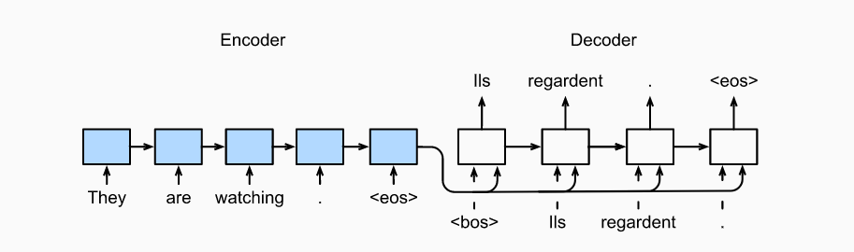
Deep learning : encoder - decoder
Translation English-French : sequence-to-sequence
Decoder predicts each successive target token given input sequence, and 1 preceding output token
Hidden layers
Encoder:
Word -> number
Decoder:
Number -> word

Slide 21
Deep learning : encoder - decoder
Performing well for short sentences
Issues with longer sentences : much information in last hidden state that has to ‘remember’ the whole input
Hidden layers

Slide 22
Deep learning : encoder - decoder
Context vector / attention mechanism indicates decoder at each step,
to which part of the input sequence to pay most attention to (probability values)
Hidden layers
Context
vector
0.15
0.2
0.6
0.05

Slide 23
Deep learning : encoder - decoder
Issues with longer sentences : much information in last hidden state that has to ‘remember’ the whole input
Is this how we translate text as humans? Now, we rather focus on a few words at a time.
Hidden layers

Slide 24
BERT transformer : model definition
BERT LM for context modeling
Transformer with a fully (self-)attention-based approach [Vaswani et al., 2017],
Learns long-range dependencies in a sequence
Self-attention or intra-attention relates different positions in a sequence
Similar to seq2seq model : encoder – decoder

Slide 25
BERT transformer : model definition
BERT LM for context modeling
Transformer with a fully (self-)attention-based approach [Vaswani et al., 2017],
Learns long-range dependencies in a sequence
Self-attention or intra-attention relates different positions in a sequence
Similar to seq2seq model : encoder – decoder
Bidirectional Encoder Representations from Transformers [Devlin et al., 2018]
Only encoder
Unsupservised pre-training
Supervised fine-tuning for specific NLP tasks
Deep learning : Hidden feature representations learned from data
word embeddings

Slide 26
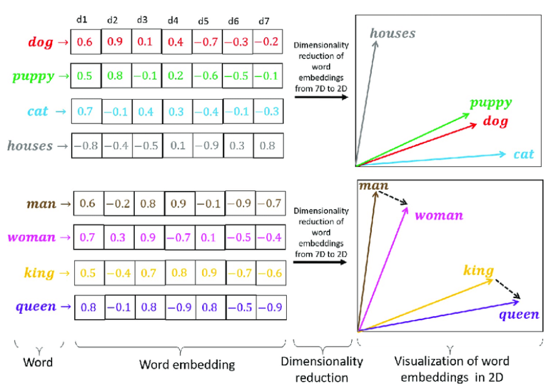
BERT transformer : word embeddings
Word embeddings contain meaning : represented by vectors of numbers
Semantically similar words,
Closer in vector space:
-puppy - dog
-king - queen
-man - woman

Slide 27
BERT transformer : word embeddings
Distance measured with cosine similarity
Y
cosinus
prince
0
-1
1
princess
X
0.7

Slide 28
BERT transformer : self-attention
Self-attention
You have to spot e-mail addresses in a document as fast as possible
What do you attend to?

Slide 29
BERT transformer : self-attention
Self-attention
You have to spot e-mail addresses in a document as fast as possible
What do you attend to? @
While reading a book you encounter a sentence with missing words:
The cat ….

Slide 30
BERT transformer : self-attention
Self-attention
You have to spot e-mail addresses in a document as fast as possible
What do you attend to? @
While reading a book you encounter a sentence with missing words:
The cat ….
What type of word do you expect?
The cat eats
The cat sleeps
The cat on the mat sleeps

Slide 31
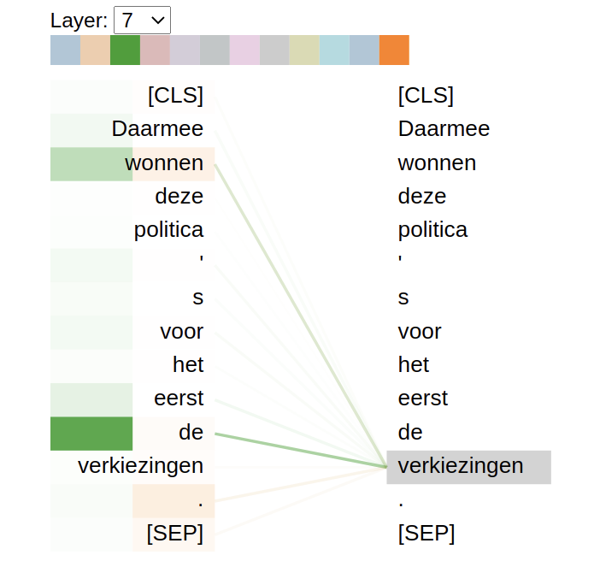
BERT transformer : self-attention
Self-attention (example Dutch BERT model ‘BERTje’)
Allows each word (query) : ‘verkiezingen’
to attend to other relevant words of the same sequence (keys ) : ‘wonnen, de’
This allows the model to learn the context of a word based on its surroundings (left and right) -> bidirectional
Transformers are big and slow
However, computations are done in parallel
Which makes it faster

Slide 32
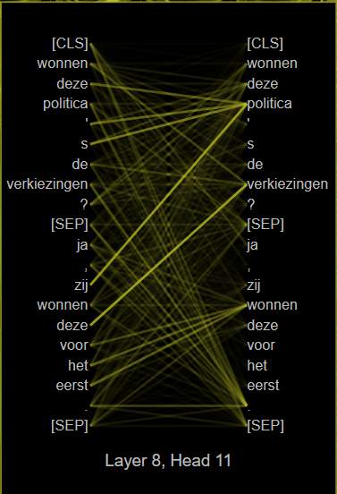
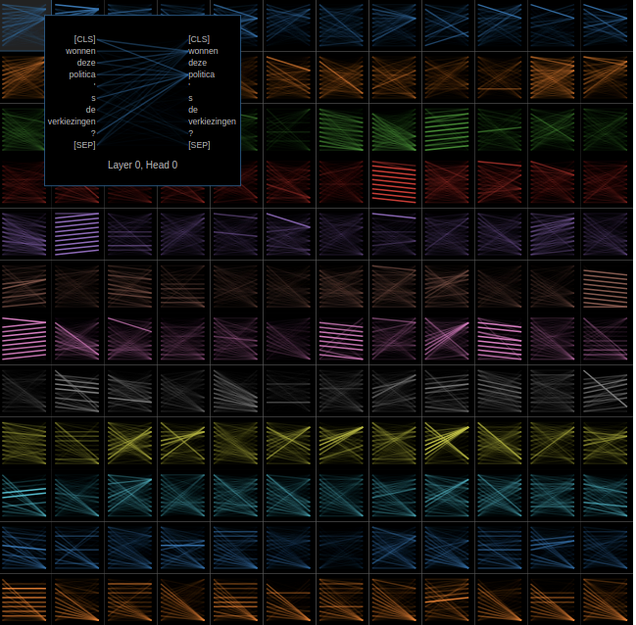
BERT transformer : self-attention
BERT is a language model : language understanding
Bert Removes the decoder
Multi-layers of the encoder
Typically 12 layers x 12 heads
Each cell represents a linguistic process
For instance coreference
Dutch BERT model (BERTje)

Slide 33
BERT transformer : general and domain specific language model
The LLM family:
General : BERT (Bidirectional Encoder Representations from Transformers)
[Devlin et al., (2018)], RoBERTa [Liu et al., (2019)]
Multi-lingual vs. mono-lingual (possibly underresourced language)
Dutch BERTje [De Vries et al., (2019)], RobBERT [Delobelle et al, (2020)]
Multi-lingual : mBERT
French : CamemBERT
Domain specific medical – scientific:
BioBERT [Lee et al., (2020)] , SciBERT [Beltagy et al., (2019)]

Slide 34
BERT transformer : language model
NLP
Neural machine translation
Question answering
Sentiment analysis
Event extraction
Text generation
Needs language understanding

Slide 35
BERT transformer : language model
NLP
Neural machine translation
Question answering
Sentiment analysis
Event extraction
Text generation
BERT pre-training + fine-tuning
Pre-train a BERT model to understand language : unsupervised learning
Typically trained on millions of sentences
Produces word embeddings
Needs language understanding

Slide 36
BERT transformer : language model
NLP
Neural machine translation
Question answering
Sentiment analysis
Event extraction
Text generation -> ChatGPT
BERT pre-training + fine-tuning
Pre-train a BERT model to understand language : unsupervised learning
Typically trained on millions of sentences
Produces word embeddings
Fine-tune BERT for a specific NLP task : supervised learning
Transfer learning training with smaller data set for target NLP task
Using pre-trained word embeddings
Needs language understanding

Slide 37

BERT transformer : language model
NLP application : text generation
Under the hood : transformer model
Encoder – decoder structure
Encoder processes the input – user query
Decoder generates the output – response
Self-attention
Allows the model to capture contextual relationships and dependencies between words more effectively, significantly enhancing its ability to generate coherent and contextually relevant responses
Possible to fine-tune
Why exploring other models than ChatGPT

Slide 38
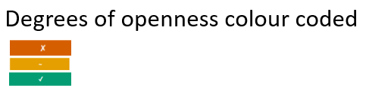
BERT transformer : language model
Degrees of openness in language models
[Liesenfeld et al., (2023)] evaluating LLMs in 15 text generation systems on accessibility of:
Data on which they are pre-trained, fine-tuned
Documentation
Code, architecture
ChatGPT model
In the cloud
Open source models (Hugging face)

Slide 39
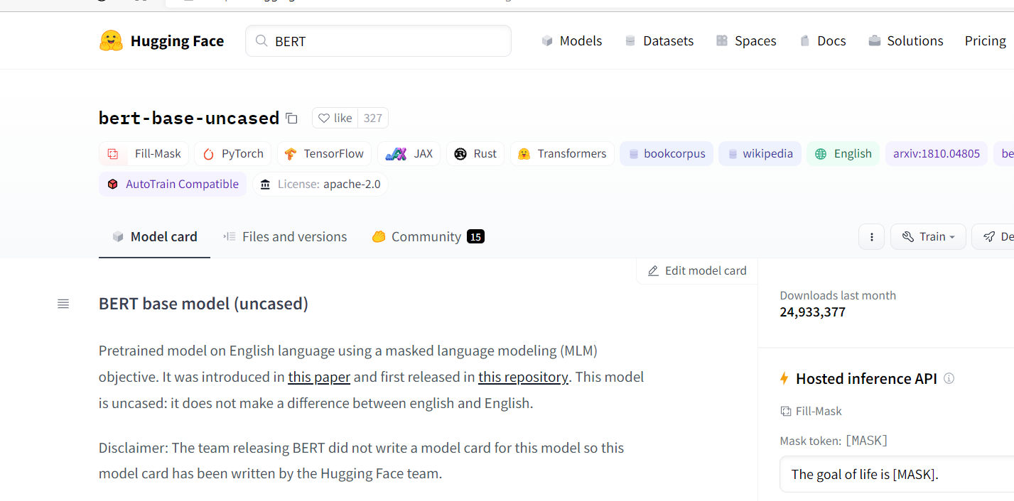
BERT transformer : huggingface
Pretrained models:
https://huggingface.co

Slide 40

BERT transformer : pre-training and fine-tuning
BERT pre-train unsupervised learning
BERT fine-une
Supervised learning
For example sentiment analysis
Number of deaths for leading causes of death:
Heart disease: 696,962; Cancer: 602,350;
COVID-19: 350,831…
Transfer learning
Sentiment label :
Negative
Billions of tokens
Unfiltered data
Thousands of tokens

Slide 41
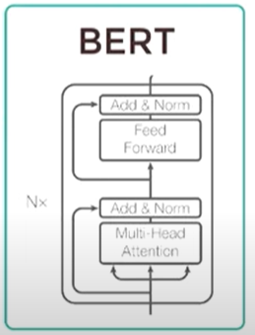
BERT transformer : pre-training
Pre-training: language and context :
Unsupervised training
Masked language Model (MLM)
-> context within a sentence
Next sentence prediction (NSP)
-> context across sentences
[MASK 1] = ‘quick’
[MASK 2] = ‘jumped’
The [MASK 1] brown
Fox [MASK 2] over
the lazy dog.
Simul-
taneous
Yes, sentence B. follows sentence A.
His name is Bert
He lives in Sesame street

Slide 42
BERT transformer : pre-training
Masked language Model (MLM)
15% of words are replaced by a mask before feeding it to BERT
The model attempts to predict the masked words
Input: The quick brown fox jumped over the lazy dog.
New input: The [MASK] brown fox [MASK] over the lazy dog.
Predicted: quick sleeps
BERT

Slide 43
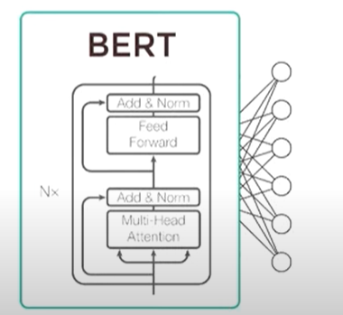
BERT transformer : fine tuning
Fine tuning = fast
Fine tuning: downstream specific NLP task
Using pre-trained word features with transfer learning
For example : Single sentence classification
Supervised training
-> Fine tune
Sentence
Predicted Class label
Class label

Slide 44
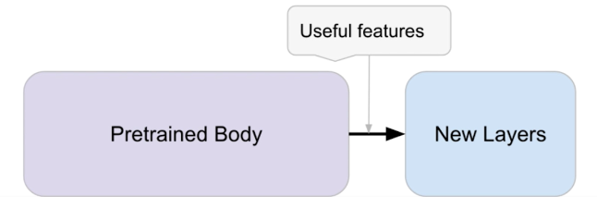
BERT transformer : fine-tuning
Pre-trained:
Just use an already trained model for your purpose
We use them in ‘predict mode’
Fine-tuning:
Fine-tune for downstream NLP task -> Transfer learning
Add your target data to the model
Idea : chop off one (or more) layers, add one (or more) new layers (with randomly initialized weights) for downstream NLP task
freeze pre-trained model weights and only train last layer

Slide 45
BERT transformer : tokenization
Tokenize
String split, split words + punctuation, characters, subwords
Map tokens to integers
E.g. I like cata -> [420, 650, 103]
Subword tokenization :
Split words into multiple tokens
running = run + suffix = runn ing
Different transformer models use different tokenization schemes
Each model has a model specific tokenizer

Slide 46
BERT transformer : 3 usage levels
1 Apply a pre-trained model
Sentiment-analysis
Zero-shot learning
Text generation
Masked language model
Named entity recognition
Text summary
Translation
Q&A
2 Fine-tune a pre-trained version for your proper use:
For instance you want chatgpt being able to answer to specific questions about your own company
3 Pre-train a new model from scratch
Lots of computing power, GPUs needed

Slide 47

Sentiment analysis
I really wasted my time watching that movie.
I watched a movie yesterday.
I really enjoyed that movie.

Slide 48
Sentiment analysis
Binary classification (positive - negative)
Multi-class (positive – negative - neutral )

Slide 49

Sentiment analysis
Binary classification (positive - negative)
Multi-class (positive – neutral - negative)
Fine-grain (very- positive – positive – neutral – negative – very negative)
Depending on the data set and how it is labelled

Slide 50
Sentiment analysis
Binary classification (positive - negative)
Multi-class (positive – neutral - negative)
Fine-grain (very- positive – positive – neutral – negative – very negative)
Depending on the data set and how it is labeled
Pre-trained + fine-tuned model

Slide 51
Usefulness of sentiment analysis
Analyse sentiment in twitter, facebook messages, social media
For business :
predict financial trends, buy or sell actions
Analyse your competitors
Customer satisfaction analysis
Reports analysing sentiment over time

Slide 52
Why transformer models for sentiment analysis
Compared to bag of words (BOW):
BOW : ordering and relationships are lost
Working with BOW :
This was a good movie
This was a bad movie
More challenging for BOW
This was a good movie
I cannot say this was a good movie
Better to use deep learning models, or transformers for long dependency relations in a sentence.

Slide 53
Sentiment analysis assignment
Sentiment classifier with pre-trained DistilBERT model : pipeline sentiment-analysis
1500 test instances (from a data set of 14k instances):
500 negative
500 positive
500 neutral
Data set preparation/analysis -> prediction -> evaluation
Twitter data set .csv file and read into Pandas data frame
Read into Pandas data frame
Test input
500 negative
500 positive
positive
Pre-trained
model
negative

Slide 54
Zero-shot learning
Normally a model is trained using a labelled data set (supervised learning)
For instance binary classification task : Spam or no spam ?
Training data have been labelled with classes spam – no spam
When applying your trained model, it is the only task it is capable of
Ideal is a model that is so powerful that it can do any classification task
That would be a model to which you can ask :
is this news paper article about business, culture, health, entertainment & arts etc.?

Slide 55
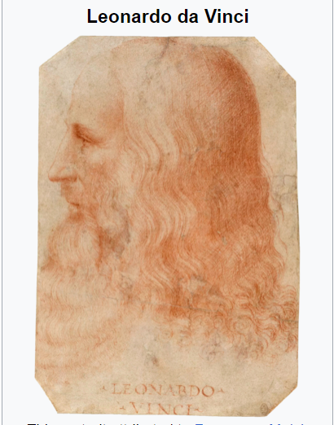
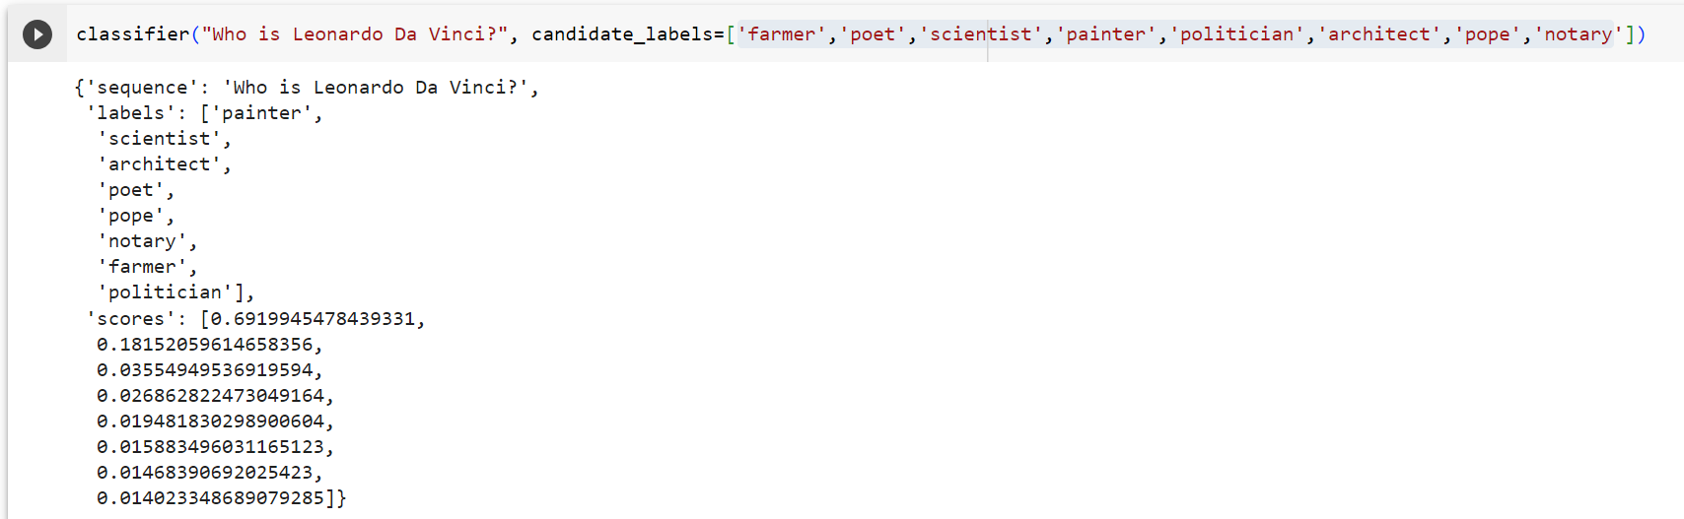
Zero-shot learning
Who is Leonardo Da Vinci?
Classes ['farmer','poet','scientist','painter','politician','architect','pope','notary]
Softmax probabilities sum to 1

Slide 56
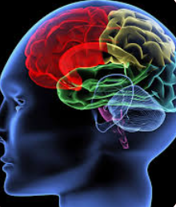
Zero-shot learning
Why is it interesting?
We don’t have several brains for several tasks
We only have one brain to do all tasks
You can classify a sentence given a list of categories, without first needing to see many examples of each
However, that might not always be the case for totally new categories

Slide 57
Zero shot learning assignment
Classifier with pre-trained DistilBERT model : pipeline zero-shot-classification
1500 test instances (from a data set of 14k instances):
Maybe the model is capable of classifying neutral sentiments, if zero-shot learning can do any classification task?
Data set preparation/analysis -> prediction -> evaluation
Twitter data set .csv file and read into Pandas data frame
Test input
500 negative
500 neutral
500 positive
positive
Pre-trained
model
neutral
negative

Slide 58
Assignments extra
Cosine similarity
Read and test small script for cosine similarity
Adapt 2 scripts based on 1st script about cosine similarity
Write a variation

Slide 59
References
Vaswani et al., (2017), Attention is all you need
Devlin et al., (2018), Bert: Pretraining of deep bidirectional transformers for language understanding
Clark et al., (2019), What does Bert look at? An analysis of Bert’s attention
De Vries et al., (2019), Bertje: A Dutch Bert model
De Vries et al., (2020), What’s so special about BERT’s layers? A closer look at the NLP pipeline in monolingual and multilingual models
Rogers et al., (2020), A Primer in BERTology, What we know about how BERT works?
Vig, (2019), A multiscale visualization of attention in the transformer model
Vig et al., (2019), Analyzing the structure of attention in a transformer language model
Liu et al., (2019), Roberta: A robustly optimized bert pretraining approach
Beltagy et al., (2019), SciBERT: A pretrained language model for scientific text
Lee et al., (2020), BioBERT: a pre-trained biomedical language representation model for biomedical text mining
Liesenfeld et al., (2023), Opening up ChatGPT: Tracking openness, transparency, and accountability in instruction-tuned text generators

Slide 60
Thanks!

